Slide 1
Validation of Camera Calibration

Slide 2
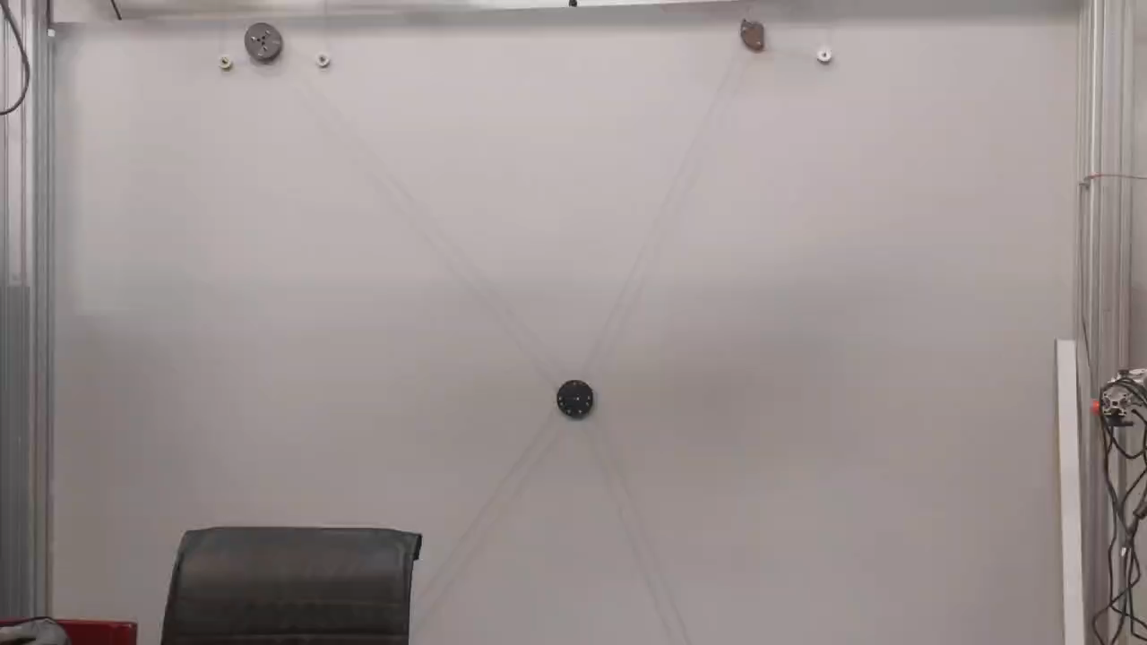
Kamal-ol-Molk

Slide 3
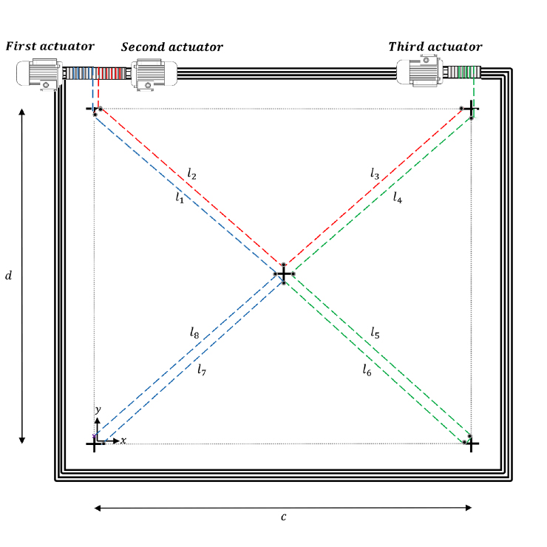
Kamal-ol-Molk

Slide 4
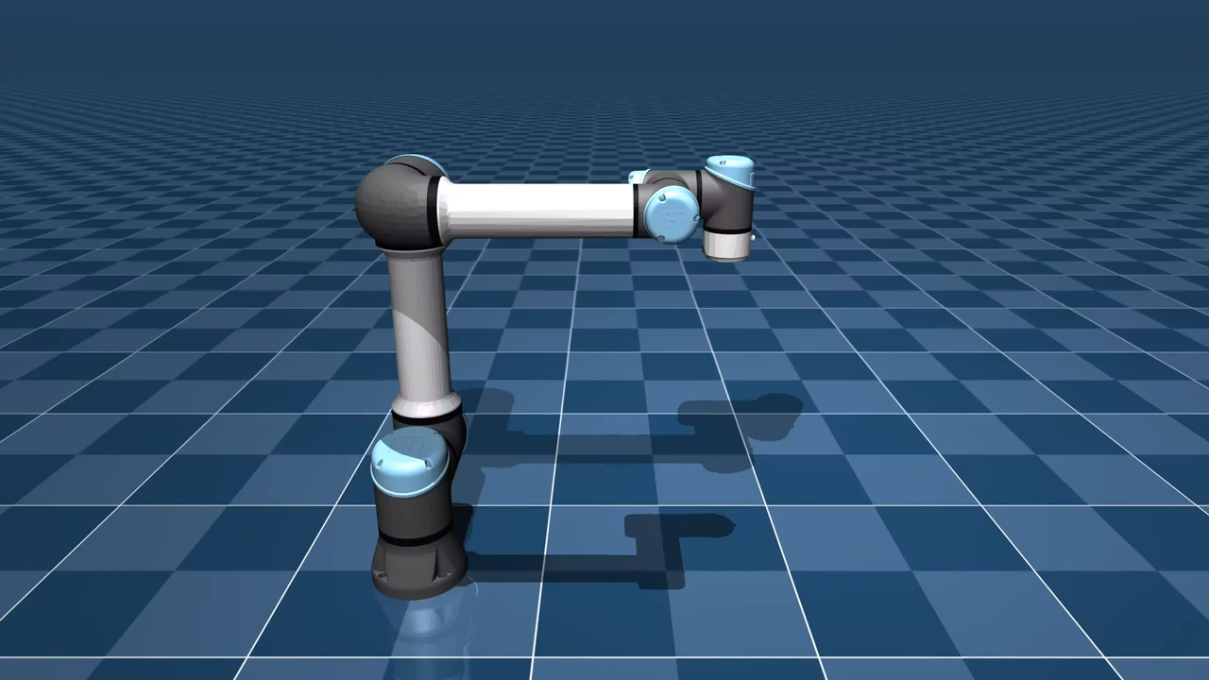
MuJoCo (Multi-Joint dynamics with Contact)
MuJoCo is a physics engine designed for research and development in robotics, biomechanics, graphics, and animation.
Developed by Emo Todorov at the University of Washington.

Slide 5
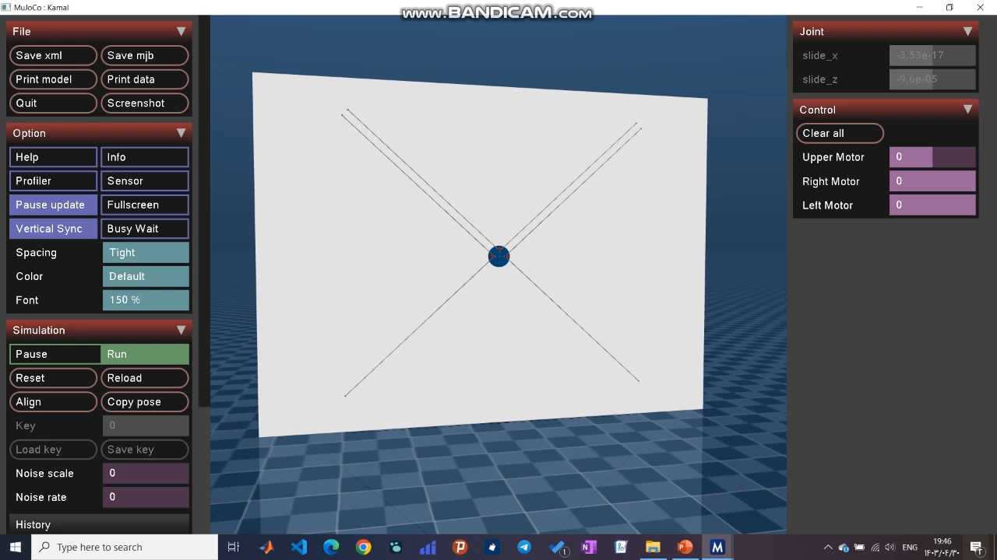
Simulating Kamal in MuJoCo

